Slide 1






E-COMMERCE ANALYSIS
Student Details
Name: Subhashini E G
NM ID: aut513321105702
College Name: University College of Engineering - Arni

Slide 2
E-Commerce Analysis
Disclaimer
The content is curated from online/offline resources and used for educational purpose only

Slide 3

Course Outline
E-Commerce Analysis
Abstract
Problem Statement
Aims, Objective & Proposed System/Solution
System Deployment Approach
Model Development & Algorithm
Future Scope
Video of the Project
Conclusion
Reference

Slide 4


E-Commerce Analysis
Abstract
The E-Commerce Analysis project offers a comprehensive approach to analyzing retail sales data and providing actionable insights for optimized operations. By leveraging data from sales records, the project explores monthly and hourly sales trends, city-specific sales performance, popular product demand, and common product combinations. These insights guide businesses in tailoring their sales strategies, managing inventory efficiently, and targeting marketing efforts more effectively

Slide 5


E-Commerce Analysis
Problem Statement
Conduct an exploratory data analysis to gain insights into sales performance, sales trends
Customer purchasing patterns across different cities, products, and time periods.

Slide 6

E-Commerce Analysis
Aim and Objective
Aim: The primary objective of this Final Seminar is to present the outcomes and advancements made in the project “E-Commerce Analysis”.

Slide 7
E-Commerce Analysis
Objectives
1. Data Acquisition and ingestion :
Gather data from diverse sources such as online store transactions, sales records , and other relevant datasets.
Automate the data ingestion process using cloud-based data pipelines.
2. Data Cleaning and Processing:
Clean and preprocess the raw data by handling missing values, correcting data types, and removind duplicates.
Transform data into a suitable format for analysis and model training.
3. Exploratory Data Analysis(EDA):
Perform exploratory data analysis to identify trends, patterns, and insights within the data.
Create visualizations such as charts and graphs to communicate findings to stakeholders.

Slide 8

E-Commerce Analysis
Proposed Solution
Load the CSV files from the specified folder and combine them into a single DataFrame.
Clean the data by excluding rows with headers and missing values.
Extract features such as year, month, hour, and city from the data.
Analyze the data with histograms, boxplots, and bar charts.
Examine sales patterns across different time periods and cities.
Calculate monthly and yearly probabilities for specific products.
Notes:
8

Slide 9
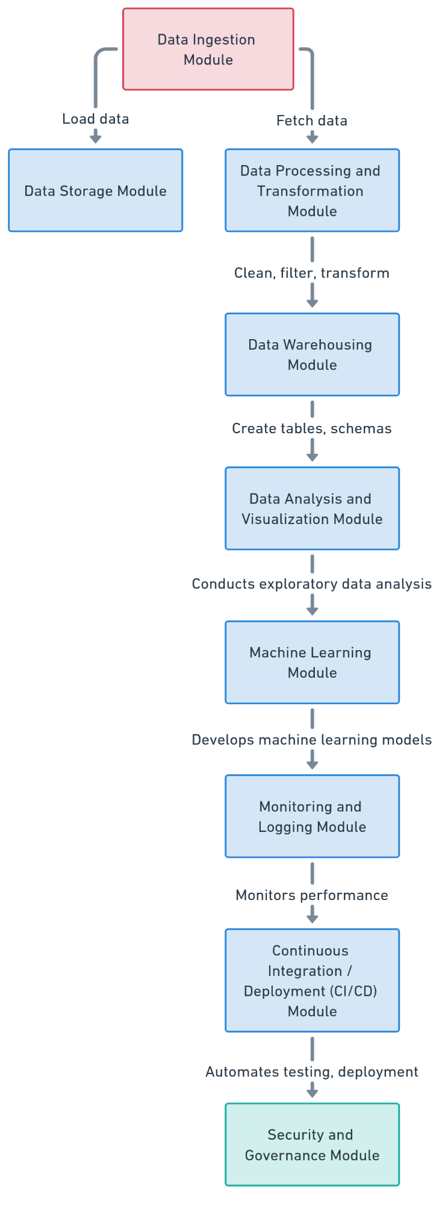
E-Commerce Analysis
System Deployment Approach
Notes:
9

Slide 10
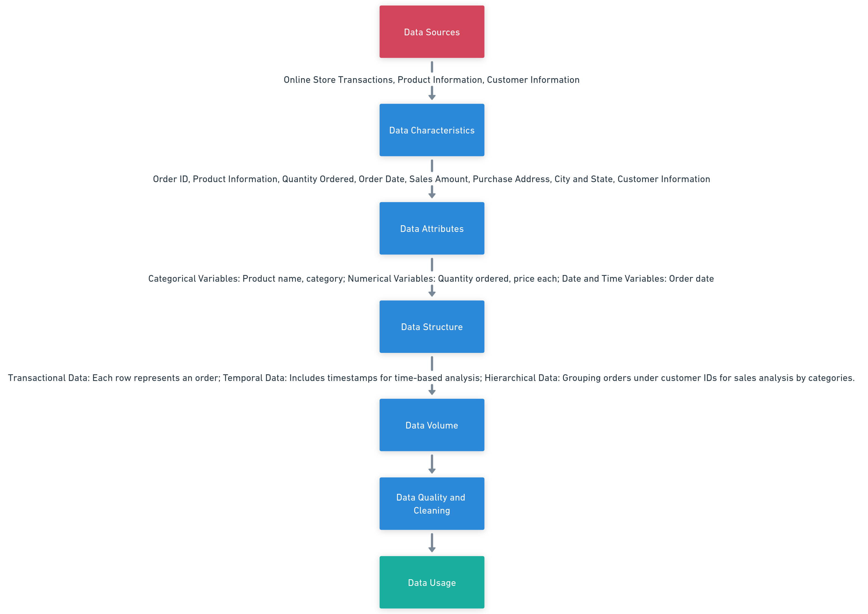
E-Commerce Analysis
Model Development & Algorithm
Dataset Description:
Notes:
10

Slide 11
E-Commerce Analysis
Model Development & Algorithm
Model Training and validation:
Train the selected model on the training data and optimize hyperparameters.
Validate model performance using cross-validation and other techniques.
Model Evaluation:
Evaluate model performance using appropriate metrics(e.g., accuracy, precision, recall, RMSE).
Compare model results to select the best-performing model.
Model Deployment and Prediction:
Deploy the trained model for real-time predictions and make the model available as a service.
Use the model to predict outcomes based on new input data.
Notes:
11

Slide 12
E-Commerce Analysis
Model Development & Algorithm
Regression problems: Algorithms such as linear regression, random forest regressor , and gradient boosting machines (GBM) are suitable for predicting continuous outcomes like sales forecast.
Classifications problems: Logistic regression, decision trees, random forest classifier, support vector machines(SVM), and neural networks are effective for binary and multi-class classification tasks.
Recommendation Systems: Algorithms such as collabrative filtering, content-based filtering, and matrix factorization help provide personalized product recommendations based on user-item interactions and preferences.
Notes:
12

Slide 13
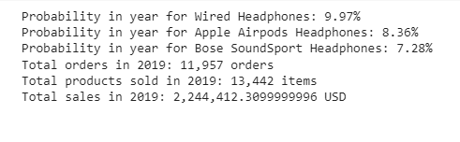
E-Commerce Analysis
Result
Notes:
13

Slide 14

E-Commerce Analysis
Future Scope
The future scope of the project encompasses several areas that can further enhance its capabilities and impact. One potential development is the integration of additional data sources such as customer reviews, demographic data, and competitive market data, providing a more comprehensive view of sales performance and customer behavior. Machine learning algorithms can be employed to predict future sales trends and identify potential areas for growth, enabling more precise and proactive decision-making. Advanced analytics can also be used to uncover deeper insights into customer preferences and emerging market trends.
Notes:
14

Slide 15
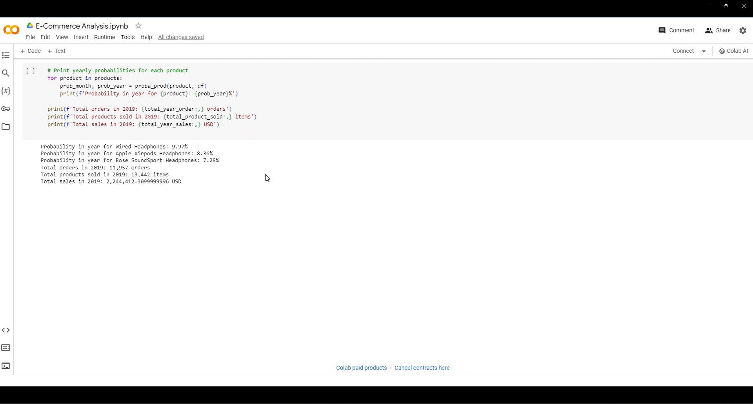
E-Commerce Analysis
Video of the Project
Notes:
15

Slide 16

E-Commerce Analysis
Conclusion
The project serves as a valuable tool for retail businesses seeking to optimize their operations and improve performance. By leveraging sales data, the project generates actionable insights that inform decision-making in various areas, including sales strategies, inventory management, marketing, and customer service. Insights into monthly and hourly sales trends enable businesses to tailor their strategies to peak demand periods, resulting in improved sales and profitability. Analysis of popular products and city-specific sales helps businesses manage inventory more effectively, ensuring that in-demand products are consistently available and avoiding overstock.
Notes:
16

Slide 17
E-Commerce Analysis
Reference
Project Github link (https://github.com/SUBHASHINI299/E-Commerce/tree/main), Subhashini E G, 2024
Project video recorded link (https://www.youtube.com/watch?v=lhjn4qI28eg), Subhashini E G, 2024
Project PPT & Report github link (https://github.com/SUBHASHINI299/E-Commerce/tree/main/Report%20and%20PPT), Subhashini E G, 2024
Project Dataset Github link (https://github.com/SUBHASHINI299/E-Commerce/tree/main/Dataset), Subhashini E G, 2024
GIT Hub Link of Project Code:
https://github.com/SUBHASHINI299/E-Commerce/tree/main/Code
Notes:
Reference
These are the references for this session.

Slide 18
E-Commerce Analysis
Thank you!
Notes:
18

